Slide 1
Welcome!
We will get started at 4:00 EST
You can find all the resources needed for today in our tool kit at: http://equityliteracy.org/toolbox2
Introductions: In the chat…
Name, location, and your favorite springtime activity

Slide 2
Racial Equity Facilitator Training, Day 4!
Host: Seema Pothini
Facilitators: Marceline DuBose & Paul Gorski
http://EquityLiteracy.org

Slide 3
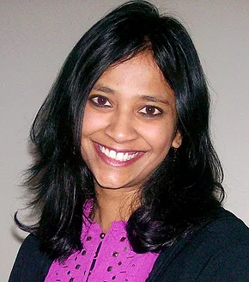
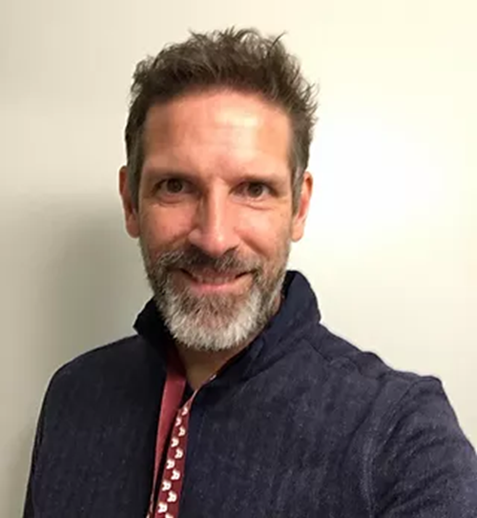
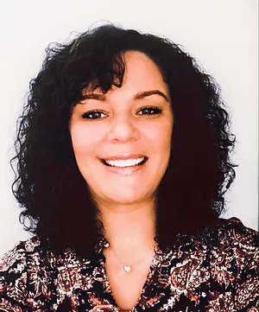
Welcome
Quick re-intros
Grounding Thought: In the chat…
Any tips or considerations for virtual vs. in-person equity facilitation?

Slide 4
A Few Notes
4-6:30 ET, with 15-minute break
Yes, we are recording
Take notes on what is said, all slides are provided to you. (you may want to timestamp your notes)
Please share your thoughts and questions in the chat! we will be gathering questions for an open Q & A during the final 20 minutes.

Slide 5
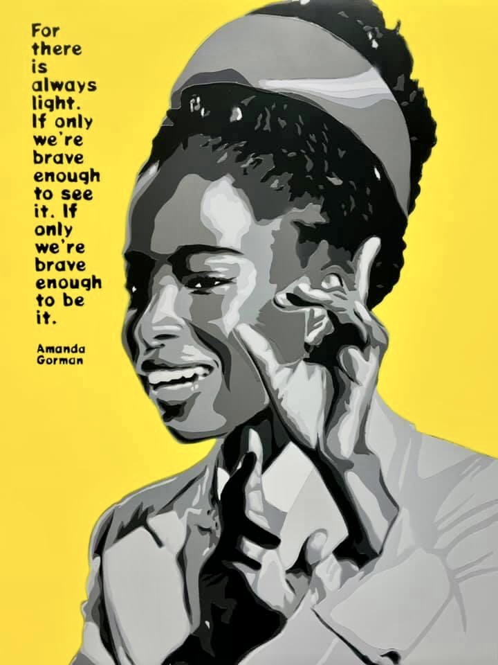
Announcements!
Free Classroom Posters! (MSP) mrjohnsonpaints@gmail.com
Free Saturday classes! that recognize, emphasize and humanize Blackness www.makingusmatter.com
We’re hiring! an Admin Assistant
Train the Trainer Pt. 2! https://facilitators2.eventbrite.com

Slide 6
Avoiding Equity Detours

Slide 7
What Do We Mean by Equity Detours?
Things we might do to create the optics of equity progress
Ways we might avoid the hard work of equity by focusing on things that are more manageable and less transformative

Slide 8
Pacing for Privilege Detour
Pacing equity work in a way that prioritizes the comfort and interests of people with privilege over progress toward equity.
Example: “We’re not ready for that.”

Slide 9
Deficit Ideology Detour
Focusing on adjusting the cultures, mindsets, values, emotions, or grittiness of people who are marginalized rather than adjusting the conditions that marginalize people, like racism.
Example: Gap between strategies to address discipline disproportionality and the actual causes of discipline disproportionality.

Slide 10
Celebrating Diversity Detour
Mistaking celebrations of diversity for progress toward equity.
Example: “Diverse Friends Day” and why celebrating diversity in the absence of racial justice is for white people.

Slide 11
Colorblindness Detour
Trying to address racism by pretending race doesn’t exist

Slide 12
Shiny New Thing Detour
Relying on popular programs and initiatives that were never designed with equity in mind to do the equity work for us

Slide 13
Individualizing Equity Detour
Focusing only on implicit bias or interpersonal conflicts rather than institutional inequity as embedded in policies, practices, and systems

Slide 14
Reflection
Which detour do you struggle with personally? Which do you see operating most prominently in your organization? What is it about the institutional culture that results in the detour being so prevalent?
Pacing for privilege
Deficit ideology
Celebrating diversity
Colorblindness
Shiny new thing
Individualizing equity

Slide 15
Basic Equity Literacy Principles

Slide 16
Direct Confrontation Principle
A racial equity commitment requires direct confrontations with inequity. Avoid strategies, programs, and initiatives that are not a threat to inequity.
Identify the inequity, eliminate the inequity, develop actively equitable policies, practices, and institutional cultures.

Slide 17
Prioritization Principle
We must actively prioritize the interests of people whose interests historically have not been prioritized.
The institutional racism trouble with defining equity only as “giving all people what they need.” Equity is about individual access and institutional change.

Slide 18
Equity Ideology Principle
Equity requires more than practical strategies. It is a lens and an ideological commitment. Sustainable shifts in practice are driven by ideological shifts.

Slide 19
Evidence-Informed Principle
Our equity efforts should be based on evidence for what works rather than what is trendy. “Evidence” can mean big quantitative studies, but it also can mean the stories of people who are marginalized in your institution.

Slide 20
#FixInjusticeNotPeople Principle
Equity efforts never focus on “adjusting” the cultures, mindsets, values, emotions, or attitudes people from marginalized groups. They always focus on transforming conditions that marginalize and oppress people from marginalized groups.

Slide 21
Reflection
Which of these principles would be the most transformative to your racial equity work? Which makes you most anxious? Which would illicit the most resistant in your organization?
Direct confrontation
Prioritization
Equity ideology
Evidence-informed
Fix Injustice, Not People

Slide 22
Managing (group, interpersonal and personal) Resistance to Equity and Anti-racism conversations

Slide 23
Why We Experience Resistance:
People do not shift their ideologies easily nor very often willingly. Humans are inclined to take the path of least resistance, to maintain the comfortable.

Slide 24
Why We Experience Resistance:
pushing on comfort zones
upsetting what people are ‘used to’ and ‘how it has always been’
revealing and challenging the areas where people have privilege
countering some narratives that people have been told their whole life
questioning peoples’ hierarchical place in the system and the merit of their status
challenging people’s beliefs, perhaps even deeply held religious beliefs or hard-earned professional training

Slide 25
Why We Experience Resistance:
In short:
we are upsetting peoples’ foundational ideologies and sense of security.
Systems of inequality maintain and replicate with the collusion of individuals

Slide 26
What are some examples of typical resistance you have encountered?

Slide 27
Resistance Behaviors
Sometimes it is loud, vocal, and visible. It might look like a person or group making public statements or taking actions that challenge equity and justice.
Sometimes it is stubborn and obstinate, people or groups refusing to participate or collaborate to create or expand equity and justice.
Sometimes it is passive aggressive, it could look like lobbying colleagues or leadership behind the scenes to resist equity and justice measures.
Sometimes it is lethargic or stuck, cycling through analysis paralysis with little movement or action.
Sometimes it is self-centering, focusing on personal feelings (guilt, fear, confusion etc.) over systemic progress.
Sometimes it is purely saboteur, refusing to acknowledge the existence of racism, inequity, or oppression or the need for systemic change.

Slide 28
First, we must make the decision of whether to engage in productive dialogue with a resistor or to shut it down from the start?
This decision often hinges on your perception of the intention on the part of the resistor.

Slide 29
Engage when…
it feels like other people in the room have the same question.
it feels like the resistor is open to hearing new ideas and/or their question comes from a genuine place of confusion or concern.
a resolution to the resistance will create healing for the group (i.e. someone was being harmed in the moment, so it must be addressed.
the idea or question has come up multiple times from different people.
the exchange will serve as modeling or an example for others of how to handle an inequitable situation (especially if the resistor has positional or relational power in the group.
Others?

Slide 30
Shut it down when…
it feels like the resistor’s intention is to be disruptive, not productive.
the resistor’s comments directly attack a person or people in the room (instead of questioning ideas).
the resistor is attempting to monopolize airtime and have their voice or ideas take over the space; it’s completely derailing from content.
the resistor is participating in derailing or resisting for sport (i.e. “playing Devil’s Advocate”).
the comments are blatantly racist, sexist, homophobic, xenophobic, etc.
Others?

Slide 31
Shutting it down often looks like a short declarative statement such as:
“That comment/question is counterproductive to this session. We can talk about it after the session if you would like.” Or
“That comment/question reinforces racism/inequity/oppression and may harm others. I cannot allow it here.” and finally,
“You are free to leave.”
Others?

Slide 32
5 Types of Resistance
The Thinker
The Doer
The Minimizer
The Believer
The Fairness Seeker

Slide 33
The Thinker: “Where’s the Data?”
Resistance from the Thinker comes in a variety of ways, all with the same foundational formula: a request for “proof” and the data to back it up. One way resistance may come from the Thinker is in the form of skepticism– What does the data show? What are your sources? Are they reputable? Another form of resistance in which the Thinker may engage is “Devil’s Advocate” behavior; they will likely tell you that they enjoy academic discussions in the form of debate or banter and may cloak their disbelief or disagreement in “playing a role” “for argument’s sake.” They may even state that they are on board with equity work but are looking for data to convince others who are struggling to see its importance.

Slide 34
The Thinker: Facilitation Strategies
As the facilitator, have a few data points or research citations prepared. Knowing you are likely to encounter a Thinker, these few points will help to keep them engaged if their questions are genuine. It also validates your role as facilitator.
If the Thinker persists after you have given basic data to support your purpose, it is time to shift focus and move on. Share with the Thinker and the rest of the group that data rarely convinces people who are determined not to be convinced. In fact, if data could convince people that equity was important, we would not have a need for equity facilitators in the first place. The data has been there for generations; needing “more” of it is a lack of willingness to accept the narrative in the numbers.

Slide 35
The Doer: “Give me Strategies!”
The resistance from this person (or group) is all about “give me/us strategies.” Finding the solution to the problem is more important than examining the problem or finding its root cause. The Doer believes it is a waste of time to process through feelings and perspectives because they cannot be implemented as strategies in the classroom tomorrow; all discussion must have practical ends.

Slide 36
The Doer: Facilitation Strategies
Reframe the Doer’s mindset by explaining that mindsets, values and ideologies must be foundationally sound in order to implement strategies. This is because:
Without an equity mindset or ideology it is very easy to fall back into previous inequitable habits of practice (especially when one encounters even minor setbacks to the strategy or barriers in practice)
Mindset, ideology and deep values are adaptive to ever-changing circumstances and the uniqueness of the people with whom we connect.
Conversely, strategies have the assumption that “one size fits all,” which isn’t true; strategies will have a disparate impact on different people. Assuming that strategies will work regardless of the situation or people assumes that the target group (for the equity strategy) is a monolith. That often perpetuates the inequities.

Slide 37
The Believer: “I’ve Done this Before.” …I’m more woke than you…
Resistance from the Believer can be especially challenging because they are already “on board” with equity work. It will likely come in the form of frustration with colleagues who “don’t get it” and the perceived slow pace with which the work is being done. They may complain that they have “done this before,” engage in name- and text-dropping, or monopolize small- and large-group sharing time. The Believer can be especially dogmatic. And those of us who facilitate equity PD (especially white people or other privileged identities) often become the Believer when participating in another facilitator’s equity session.

Slide 38
The Believer: Facilitation Strategies
Publicly affirm their belief in equity, then ask how we can effectively and collectively move people towards a shared goal of equity. This is important reframing to help them envision building coalitions instead of identifying the “in group” and “out group” participants (thereby dividing the room and stalling progress for some) and to disrupt any righteous savior identity.
Make this person your “helper” in the space by asking them to encourage effective, productive equity work.
If this person aligns with privilege, remind them they need to recognize how they may be marginalizing other people in the room. This is especially true when they believe they can explain the -isms being discussed (ex: mansplaining); encourage them to be listeners and learners instead.

Slide 39
The Fairness-Seeker: “Equal is Fair.”
Resistance from the Fairness-Seeker frequently reveals itself in the struggle to differentiate between equity and equality. They hold tightly to rules, policies, and procedures with little interest in flexibility, even when an inequity has been identified; redistribution of access and resources is difficult for them to understand. They believe fair means equal. Because the Fairness-Seeker idealizes equality it may be especially challenging for them to believe in systemic racism; a common refrain from white people engaging in this type of resistance is, “but I grew up poor!” A lack of experience with racial inequities makes them naive even if their intentions are good– the upside is they can become ardent equity supporters if you can redirect their definition of fairness from equal to equity.

Slide 40
The Fairness Seeker: Facilitation Strategies
Explicitly teach the difference between equality and equity as this may be a new concept or new vocabulary for them. One way to do this is to
Give an example scenario, policy, or practice in which most people would agree that equal is not fair and actually has unfair impacts based on people’s identities or circumstances.
Ask the group to share examples of scenarios, policies, or practices where equal is actually unfair.
Dilute the Fairness-Seeker’s voice with other voices in the room; asking others to explain equity (versus equality) or telling stories where equal was not fair can be especially poignant for the Fairness-Seeker

Slide 41
The Minimizer: “Why Can’t We All Just (Go Along to) Get Along?”
The resistance from this role is varied and wide-ranging because it is often a large percentage of participants in the room. It can show up anywhere from “I don’t see color” to “But the real world is not fair and we are living in the real world.” The Minimizer may see a facilitator as someone who is there to “stir the pot” because they don’t see the inequities in the system and believe it is generally fair. That means they also don’t see their own role in perpetuating systems of inequity nor in the possibilities of creating a more just and equitable system. The resistance that follows is a good indicator that the Minimizer is feeling overwhelmed, uncomfortable, and wanting to maintain the peace. Because they don’t like public conflict this resistor is less likely to publicly rock the boat, but is more likely to make a snide remark to a colleague in a small group or even in a side conversation in the hallway the next day.

Slide 42
The Minimizer: Facilitation Strategies
The Minimizer often needs expanded perspective. Case studies, story-telling, testimony, videos, etc. can be particularly influential in shifting the Minimizer.
Similarly, utilizing small group discussions as a facilitation technique will help build– and diversify– perspectives, relationships and experiences for the Minimizer.
Model and name best practices; Minimizers are more likely to consider trying something new if they have seen it in action.
Acknowledge that equity work feels uncomfortable because we don’t have enough examples of what true equity looks like.
Engage in thinking mapping by using the phrase “I used to think… but now I know…” or “what if it were true?”This activity models the growth of thought. It may also feel more relational for the Minimizer (like the facilitator is walking alongside them in the journey towards equity instead of talking at them from the front of the room).

Slide 43
Types of Resistance
The Thinker
The Doer
The Minimizer
The Believer
The Fairness Seeker
Which of these types of resistance is easiest for you to navigate?
Which is most difficult?
Which do you see in yourself?

Slide 44
15-minute Screen Break! Some ideas…
Water the plants
Throw in a load of laundry
Dance to a song or two
Step out and take a deep breath of fresh air
Hug someone in your house
Stretch or yoga
Walk the dog

Slide 45
Using Case Studies

Slide 46
Case Study Analysis Framework
You can find many case studies in our tool kit at: http://equityliteracy.org/toolbox2
Ours are mostly about education or working with youth, but feel free to modify in ways that serve your work.
Let’s walk through an example. We’ll look at the one linked on the resources page, Black Lives Matter!

Slide 47
Let’s Practice! Case Study…
Black Lives Matter!

Slide 48
Case Study Group Analysis
Recognize inequity
Respond to inequity
Redress inequity
Actively cultivate equity
Sustain equity
What are some reasons educators might be fearful about introducing conversations about racism in their classes? What can school leaders do to alleviate that fear? What can we do as individual educators to alleviate that fear in ourselves?
If you were a teacher at East City, how would you respond to students wearing “All Lives Matter” shirts to help them distinguish that point from the importance of a movement insisting “Black Lives Matter”?

Slide 49
Racial Equity Facilitation: Considerations and Reflections (a backstage discussion)
Why did you write the case studies? What purpose do they serve?
What has been your experience using case studies with groups?
What are the limitations of case studies in group facilitation?
How do you bridge your groups from the hypothetical to reality and action?

Slide 51
One more Announcement…

Slide 52
Let’s do this again! October 2021 Facilitator Training
Tuesdays, 4-6:30 PM EST
More info:
https://facilitators3.eventbrite.com

Slide 53
http://EquityLiteracy.org
gorski@EquityLiteracy.org
@pgorski / @EquityLiteracy

