Slide 1
Racial Equity Facilitator Training, Day 4
Marceline DuBose & Paul Gorski
http://EquityLiteracy.org

Slide 2
A Few Notes
4-6:30 ET, with 15-minute break
Yes, we are recording
Our work is mostly with schools, universities, and non-profits; we’ll provide examples from different contexts
We will be using our reflection log (3-minute reflection time between ideas)
https://www.equityliteracy.org/toolbox
Please share your thoughts and questions in the chat!
Use the Q/A for questions you want seen by the panelists

Slide 3
Welcome
Check-in!—the chat…
What questions remain on your heart or your mind following our discussions of the past 3 weeks?

Slide 4
Managing Resistance to Racial Equity PD

Slide 5
Why We Experience Resistance:
People do not shift their ideologies easily nor very often willingly. Humans are inclined to take the path of least resistance, to maintain the comfortable.

Slide 6
Why We Experience Resistance:
pushing on comfort zones
upsetting what people are ‘used to’ and ‘how it has always been’
revealing and challenging the areas where people have privilege
countering some narratives that people have been told their whole life
questioning peoples’ hierarchical place in the system and the merit of their status
challenging people’s beliefs, perhaps even deeply held religious beliefs or hard-earned professional training

Slide 7
Why We Experience Resistance:
In short: we are upsetting peoples’ foundational ideologies and sense of security.

Slide 8
What are some examples of typical resistance you have encountered?

Slide 9
First, we must make the decision of whether to engage in productive dialogue with a resistor or to shut it down from the start?
This decision often hinges on the facilitator’s perception of the intention on the part of the resistor.

Slide 10
Engage in Productive dialogue when…
it feels like other people in the room have the same question.
it feels like the resistor is open to hearing new ideas and/or their question comes from a genuine place of confusion or concern.
a resolution to the resistance will create healing for the group (i.e. someone was being harmed in the moment, so it must be addressed.
the idea or question has come up multiple times from different people.
the exchange will serve as modeling or an example for others of how to handle an inequitable situation (especially if the resistor has positional or relational power in the group.
Others?

Slide 11
Shut it down when…
it feels like the resistor’s intention is to be disruptive, not productive.
the resistor’s comments directly attack a person or people in the room (instead of questioning ideas).
the resistor is attempting to monopolize air time and have their voice or ideas take over the space; it’s completely derailing from content.
the resistor is participating in derailing or resisting for sport (i.e. “playing Devil’s Advocate”).
the comments are blatantly racist, sexist, homophobic, xenophobic, etc.
Others?

Slide 12
Shutting it down often looks like a short declarative statement such as:
“That comment/question is counterproductive to this session. We can talk about it after the session if you would like.” Or
“That comment/question reinforces racism/inequity/oppression and may harm others. I cannot allow it here.” and finally,
“You are free to leave.”
Others?

Slide 13
A theory of fear and resistance

Slide 14
SCARF Model
The SCARF Model summarizes five domains of threat or reward. The five dimensions are:
Status is about relative importance to others, or a perception of where we are in relation to the people around us. Our sense of status goes up when we feel ‘better than’ someone else, creating a reward response.
Certainty is about eliminating ambiguity. The brain is a pattern-recognition machine that is constantly trying to predict the near future, and so it craves certainty.
Autonomy is the perception of having control over our environment; a feeling of having choices. Our ability to influence outcomes triggers our threat sensors which results in fight or flight response.
Relatedness involves deciding whether we are ‘in’ or ‘out’ of a particular social group. People naturally like to form tribes where they experience a sense of belonging.
Fairness in interpersonal dealings is intrinsically rewarding, independent of other factors. People want to know that they will be treated consistently with their peers.

Slide 15
Conversations about equity deeply trigger our threat responses
The SCARF Model summarizes five domains of threat or reward. The five dimensions’ fears about equity are often expressed as:
Status: Are you saying I’m not a good person? Will I lose any of my privileged status? Are you saying I am not good at my work?
Certainty: If we make changes what will be expected of me? How will my life change? Who will help me? What are the proven best practices? Can you just tell me what to do? What does the data say?

Slide 16
Conversations about equity deeply trigger our threat responses
Autonomy: Don’t tell me what to do. I need professional freedom. I am an educator, not a robot. I need to respond to the needs of the students in my classroom. You can’t understand my day to day.
Relatedness: My students know I care about them and I would never treat them poorly. I just want ALL students to get what they need; we shouldn’t single out anyone. Let’s not make people feel bad about their work, I am sure they mean well.
Fairness: Things need to be equal. We can’t give special treatment to some students. Hard work and follow the rules and students will be fine. It’s not fair to give special treatment to some students or families.

Slide 17
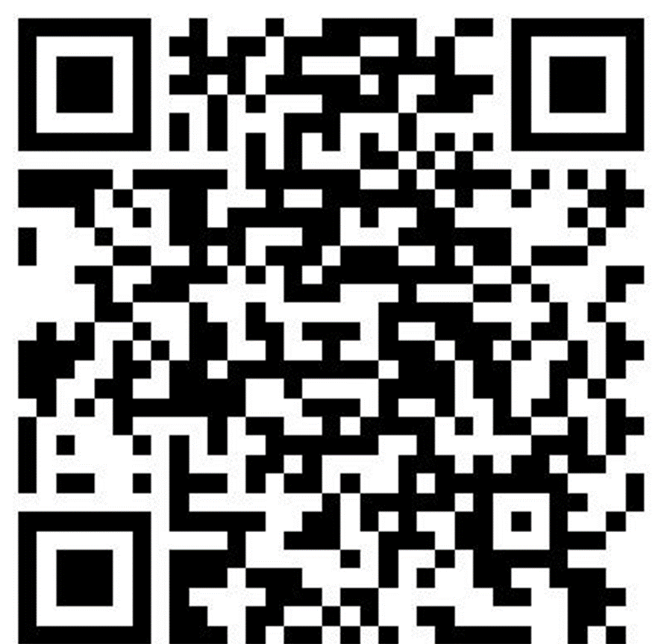
SCARF Model
Which domains of threat or reward are most prevalent for you?
Which domains of threat are you best at acknowledging and attending to?
Which are hardest for you to acknowledge or attend to?

Slide 18
The Thinker: “Where’s the Data?”
Resistance from the Thinker comes in a variety of ways, all with the same foundational formula: a request for “proof” and the data to back it up. One way resistance may come from the Thinker is in the form of skepticism– What does the data show? What are your sources? Are they reputable? Another form of resistance in which the Thinker may engage is “Devil’s Advocate” behavior; they will likely tell you that they enjoy academic discussions in the form of debate or banter and may cloak their disbelief or disagreement in “playing a role” “for argument’s sake.” They may even state that they are on board with equity work, but are looking for data to convince others who are struggling to see its importance.

Slide 19
The Thinker: Facilitation Strategies
As the facilitator, have a few data points or research citations prepared. Knowing you are likely to encounter a Thinker, these few points will help to keep them engaged if their questions are genuine. It also validates your role as facilitator.
If the Thinker persists after you have given basic data to support your purpose, it is time to shift focus and move on. Share with the Thinker and the rest of the group that data rarely convinces people who are determined not to be convinced. In fact, if data could convince people that equity was important, we would not have a need for equity facilitators in the first place. The data has been there for generations; needing “more” of it is a lack of willingness to accept the narrative in the numbers.

Slide 20
The Doer: “Give me Strategies!”
The resistance from this person (or group) is all about “give me/us strategies.” Finding the solution to the problem is more important than examining the problem or finding its root cause. The Doer believes it is a waste of time to process through feelings and perspectives because they cannot be implemented as strategies in the classroom tomorrow; all discussion must have practical ends.

Slide 21
The Doer: Facilitation Strategies
Reframe the Doer’s mindset by explaining that mindsets, values and ideologies have to be foundationally sound in order to implement strategies. This is because:
Without an equity mindset or ideology it is very easy to fall back into previous inequitable habits of practice (especially when one encounters even minor setbacks to the strategy or barriers in practice)
Mindset, ideology and deep values are adaptive to ever-changing circumstances and the uniqueness of the people with whom we connect.
Conversely, strategies have the assumption that “one size fits all,” which isn’t true; strategies will have a disparate impact on different people. Assuming that strategies will work regardless of the situation or people assumes that the target group (for the equity strategy) is a monolith. That often perpetuates the inequities.

Slide 22
The Believer: “I’ve Done this Before.” …I’m more woke than you…
Resistance from the Believer can be especially challenging because they are already “on board” with equity work. It will likely come in the form of frustration with colleagues who “don’t get it” and the perceived slow pace with which the work is being done. They may complain that they have “done this before,” engage in name- and text-dropping, or monopolize small- and large-group sharing time. The Believer can be especially dogmatic. And those of us who facilitate equity PD (especially white people or other privileged identities) often become the Believer when participating in another facilitator’s equity session.

Slide 23
The Believer: Facilitation Strategies
Publicly affirm their belief in equity, then ask how we can effectively and collectively move people towards a shared goal of equity. This is important reframing to help them envision building coalitions instead of identifying the “in group” and “out group” participants (thereby dividing the room and stalling progress for some) and to disrupt any righteous savior identity.
Make this person your “helper” in the space by asking them to encourage effective, productive equity work.
If this person aligns with privilege, remind them they need to recognize how they may be marginalizing other people in the room. This is especially true when they believe they can explain the -isms being discussed (ex: mansplaining); encourage them to be listeners and learners instead.

Slide 24
The Fairness-Seeker: “Equal is Fair.”
Resistance from the Fairness-Seeker frequently reveals itself in the struggle to differentiate between equity and equality. They hold tightly to rules, policies, and procedures with little interest in flexibility, even when an inequity has been identified; redistribution of access and resources is difficult for them to understand. They believe fair means equal. Because the Fairness-Seeker idealizes equality it may be especially challenging for them to believe in systemic racism; a common refrain from white people engaging in this type of resistance is, “but I grew up poor!” A lack of experience with racial inequities makes them naive even if their intentions are good– the upside is they can become ardent equity supporters if you can redirect their definition of fairness from equal to equity.

Slide 25
The Fairness Seeker: Facilitation Strategies
Explicitly teach the difference between equality and equity as this may be a new concept or new vocabulary for them. One way to do this is to
Give an example scenario, policy, or practice in which most people would agree that equal is not fair and actually has unfair impacts based on people’s identities or circumstances.
Ask the group to share examples of scenarios, policies, or practices where equal is actually unfair.
Dilute the Fairness-Seeker’s voice with other voices in the room; asking others to explain equity (versus equality) or telling stories where equal was not fair can be especially poignant for the Fairness-Seeker

Slide 26
The Minimizer: “Why Can’t We All Just (Go Along to) Get Along?”
The resistance from this role is varied and wide-ranging because it is often a large percentage of participants in the room. It can show up anywhere from “I don’t see color” to “But the real world is not fair and we are living in the real world.” The Minimizer may see a facilitator as someone who is there to “stir the pot” because they don’t see the inequities in the system and believe it is generally fair. That means they also don’t see their own role in perpetuating systems of inequity nor in the possibilities of creating a more just and equitable system. The resistance that follows is a good indicator that the Minimizer is feeling overwhelmed, uncomfortable, and wanting to maintain the peace. Because they don’t like public conflict this resistor is less likely to publicly rock the boat, but is more likely to make a snide remark to a colleague in a small group or even in a side conversation in the hallway the next day.

Slide 27
The Minimizer: Facilitation Strategies
The Minimizer often needs expanded perspective. Case studies, story-telling, testimony, videos, etc. can be particularly influential in shifting the Minimizer.
Similarly, utilizing small group discussions as a facilitation technique will help build– and diversify– perspectives, relationships and experiences for the Minimizer.
Model and name best practices; Minimizers are more likely to consider trying something new if they have seen it in action.
Acknowledge that equity work feels uncomfortable because we don’t have enough examples of what true equity looks like.
Engage in thinking mapping by using the phrase “I used to think… but now I know…” This activity models the growth of thought. It may also feel more relational for the Minimizer (like the facilitator is walking alongside them in the journey towards equity instead of talking at them from the front of the room).

Slide 28
Direct/Indirect Messaging

Slide 29
Direct/Indirect Communication How do you feel? What would you do?
You cook your friend’s favorite meal for them for their birthday. When they taste it, they tell you it’s too salty and their mom cooks it better.
Your neighbor’s gutters are draining directly into your yard—you are worried about flooding in your basement if there is a heavy rain. Every time you notice this, you move the drain so that is directed back into their yard. Yet you keep noticing that they shift it back. Don’t they get the point?
Your co-worker comes to you to tell you that a third co-worker share that they are stressed because you always turn in your work at the last minute. Your co-worker is wondering what you can do to get your work done in a timelier manner?

Slide 30
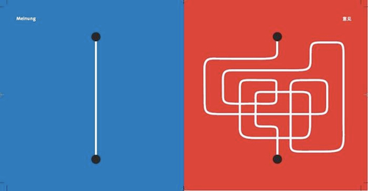
Direct/Indirect Messaging
Notes:
Reflection Questions:
How do the differences in direct and indirect communication impact teaching and learning? Family/School relationships? Classroom management?
Do direct or indirect communicators experience the privilege of belonging in your school? In your classroom?
How does direct or indirect communication support/inhibit our efforts to achieve greater educational equity?

Slide 31
Direct/Indirect Messaging
Direct
Indirect
The primary purpose of communication is to inform or decide | Primary purpose of communication is to connect or preserve relationships, to consider ideas or plans, to maintain harmony
Message and meaning are conveyed by words | Meaning is conveyed by suggestion, implication, story, questions, understatement and/or non-verbal behaviors. (pauses, silence, tone of voice etc.)
Contextual factors such as situation or timing are less important than clearly and currently communicating the message | Pays attention to contextual factors that may impact the message and relationship i.e situation or timing.
Messages are communicated directly to and between parties involved | Messages may be sent through a 3rd party or written communication
Uses definitive statements and words such as “should” and “have to” | Uses open-ended statements such as “maybe” and “possibly”
The speaker is responsible for clear communication of the message | The listener is responsible for interpreting the message and understanding the meaning
 | Avoids conflict, tension or uncomfortable situations

Slide 32
Direct/Indirect Messaging
Direct: Values and Phrases | Indirect: Values and Phrases
Tell it like it is. Get to the point. The facts speak for themselves. | If you don't have anything nice to say, don't say anything at all.
The squeaky wheel gets the grease. | Being polite is more important than being honest. If the truth might hurt, soften it.
It's okay to say no. | Avoid saying no; say “maybe” or “possibly,” even if you mean “no.”
Honesty is the best policy. The truth is more important than feelings. | Read between the lines. We mean more than we say and gather meaning beyond words.
Say what you mean and mean what you say. | Save face—do not insult others
Take communication at face value. | Small talk before business is important.
It’s okay to disagree with “superiors”, it’s okay to disagree in public. | Criticism of others, especially people with more authority, should be unspoken or careful and veiled. Should not be done in public.

Slide 33
What are the implications of direct/indirect messaging for equity facilitation?
Consider the impact on effectiveness
Consider learner outcomes
Consider facilitator/participant identities
Consider the needs of the group
Distinguish between individual/systemic
Distinguish between written/verbal

Slide 34
Comments? Questions?

