Slide 1
Welcome!
We will get started at 4:00 EST
You can find all the resources needed for today in our tool kit at: http://equityliteracy.org/toolbox2
Introductions: In the chat…
Name, location, and a book recommendation

Slide 2
Racial Equity Facilitator Training, Day 1
Host: Seema Pothini
Facilitators: Marceline DuBose & Paul Gorski
http://EquityLiteracy.org

Slide 3
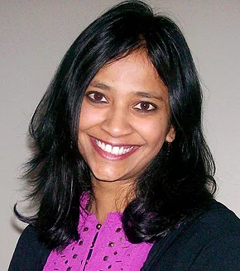
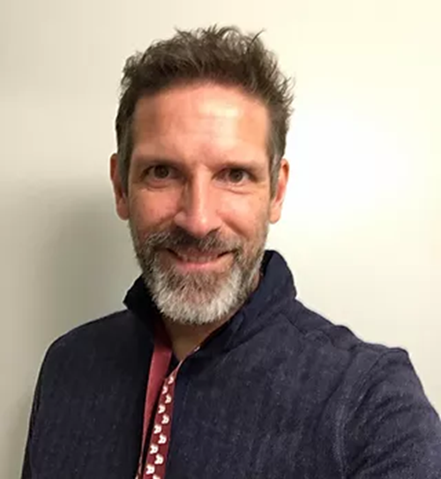
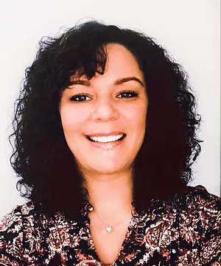
Welcome
Quick intros
Grounding Thought: In the chat…
What is your equity facilitation strength?

Slide 4
A Few Notes
4-6:30 ET, with 15-minute break
Yes, we are recording
Our work is mostly with schools, universities, and non-profits; we’ll provide examples from different contexts
We will be using our reflection log (3-minute reflection time between ideas)
Take notes on what is said, all slides are provided to you. (you may want to timestamp your notes)
Please share your thoughts and questions in the chat! Seema will be gathering questions for an open Q & A during the final 30 minutes.

Slide 5
Reflection (reflection log)
What has been your most heartwarming facilitation moment?
What has been your most frustrating facilitation moment?

Slide 6
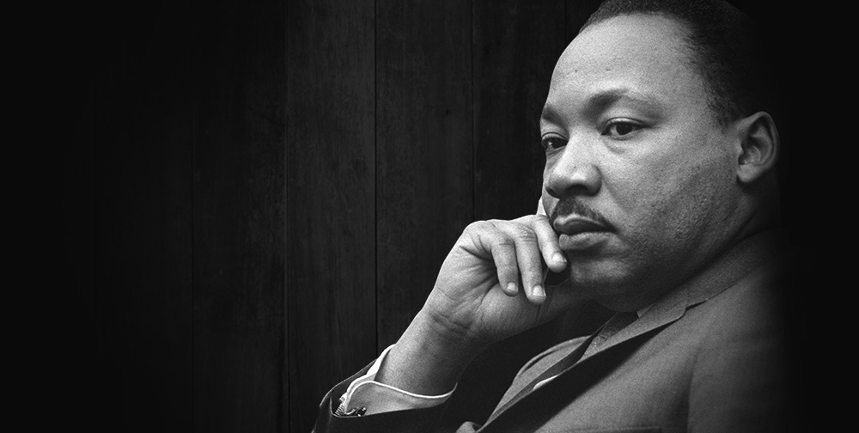
Martin Luther King, Jr.
“I have almost reached the regrettable conclusion that the Negro's great stumbling block in his stride toward freedom is not the White Citizen's Counciler or the Ku Klux Klanner, but the white moderate, who is more devoted to ‘order’ than to justice; who prefers a negative peace which is the absence of tension to a positive peace which is the presence of justice; who constantly says: ‘I agree with you in the goal you seek, but I cannot agree with your methods of direct action’; …

Slide 7
Back to Martin Luther King, Jr.
…Shallow understanding from people of good will is more frustrating than absolute misunderstanding from people of ill will. Lukewarm acceptance is much more bewildering than outright rejection.”

Slide 8
Racism

Slide 9
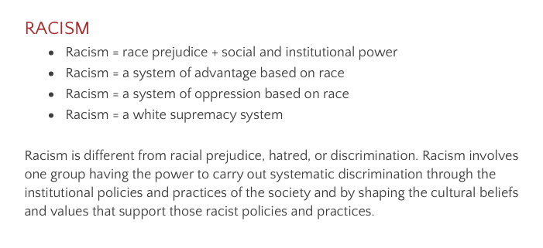
Dismantling Racism Works (DismantlingRacism.org)

Slide 10
Belief or Accumulative Impact of Social Conditions?
“Racism = a system of oppression/advantage based on race”
Note structural/accumulative understanding
I can be advantaged and participate in oppression even if I don’t believe a group is inferior to mine
Can’t just change individual people’s attitudes; have to change systems and structures, too—that “anti-bias” training is not enough (more on this soon)

Slide 11
Layers of Racism

Slide 12
The Layers
Ideological Racism
Individual Racism
Institutional Racism
Cultural Racism
Structural Racism
Sociohistorical Racism

Slide 13
Shift One
Racism as solely individual, interpersonal actions
Racism as structures of advantage and disadvantage

Slide 14
Shift Two
Racism as an occasional incident that needs to be addressed when witnessed or reported
Racism as ordinary and impacting everything, so we need to proactively be address it all the time

Slide 15
Shift Three
Racism as solely a prejudiced belief system that can be adjusted with anti-bias training
Racism as the accumulative impact of institutional, cultural, and structural racial injustice that must be addressed at their ideological, institutional, cultural, and structural core

Slide 16
Understanding “Racial Equity”: Establishing a Shared and Robust Definition

Slide 17
What you know: (reflection log)
What is inequity?
What is equity?
Why is creating a definition of equity important for group facilitation?

Slide 18
Defining Inequity
An unfair distribution of material and non-material access and opportunity resulting in outcome and experience disparities that are predictable by race, socioeconomic status, gender identity, home language, or other dimensions of identity.

Slide 19
Defining Inequity: “material and non-material"
Material access
Non-material access

Slide 20
Defining Inequity: “outcome and experience disparities"
Outcome disparities
Experience disparities (access to feelings of belonging, bias-free environments)

Slide 21
Defining Equity:
Equity is about individuals, relationships, and systems. An organization that is equitable is one in which we value and honor each person for who they are and provide the structures, environment, and resources each person needs to fully participate and reach their greatest potential. Equitable organizations see their role in and contribute to the long-term impact of creating a more just world.

Slide 22
Defining Equity
A commitment to action: the process of redistributing access and opportunity to be fair and just.
A way of being: the state of being free of bias, discrimination, and identity-predictable outcomes and experiences

Slide 23
Equity feels like:
I am valued for my strengths and contributions
I am respected for who I am
My voice is heard and appreciated
I feel cared about and I care about others
I see myself, my family, and my community represented
I feel comfortable and welcomed
I am confident and challenged
I am empowered to achieve my goals and contribute to my full potential
I see my place and responsibility in creating societal justice

Slide 24
A Basic Equity Lens…
Who is benefiting?
Who is marginalized?
How do we maximize benefit and eliminate marginalization?

Slide 25
So:
An equitable organization is not just one where we focus on individual people’s needs, but one where we:
actively identify and eliminate all forms of bias and inequity, and
actively develop anti-bias, equitable policies, practices, and cultures.

Slide 26
Components of Equity
Distinguishing equity (fairness or justice) and equality (sameness)
Identifying and eliminating racism, sexism, heterosexism, transphobia, ableism, and other forms of bias and discrimination
Fairly distributing access, opportunity, and participation

Slide 27
1. Distinguishing Equity and Equality
Acknowledging unlevel playing field
How offering equality reproduces inequity (example: stringent tardy policies)

Slide 28
1. Distinguishing Equity and Equality: Awareness Activity (in the chat)
What is an example of a policy or practice in your organization that is applied equally but still has a disproportionately negative impact a group of already-marginalized people?

Slide 29
2. Identify and Eliminate Inequity
Not just “giving each person what they need” in terms of individual attention, but also in terms of access to just policies, practices, and institutional culture
Equity as identifying and eliminating inequity

Slide 30
3. Fairly Distribute Access and Opportunity
Who has a say in policies, practices, and institutional culture? Based on whose interests are these formed?

Slide 31
Bit of Reflection
Based on our definitions of equity and inequity, what is an example of a persisting inequity in your organization? Who does the inequity harm? Who does it benefit?
If you know it’s an inequity, why does it persist?

Slide 32
Equity Literacy Framing Questions
What are the knowledge and skills I need to be a threat to the existence of inequity in my spheres of influence?
Do I have the will to be that threat?
Do I have the support to be that threat?

Slide 33
Racial Equity Facilitation: Considerations and Reflections (a backstage discussion)
Providing definition and context matters—conversations in the abstract leave room for the maintenance racism and inequity.
Offer that there are multiple definitions, consider other ideas and perspectives, but don’t get into a definition show down.
How do you feel when defining racism and inequity? Does that feel easy or difficult? Why?

Slide 34
Distinguishing Mitigative and Transformative Equity

Slide 35
Illustration: Addressing “Homelessness”
Mitigative . . . . . . . . . . . . . Transformative
What are the most common things people and organizations do in response to homelessness—to support people experiencing homelessness?

Slide 36
Parable 1: The Starfish
The “respond” ability of equity literacy—short term reaction
The trouble with the Starfish approach to equity
“Starfish” initiatives?

Slide 37
Parable 2: The Babies in the River
The “redress” ability—transformative change at the roots
The difficulty of transformative approaches
Transformative initiatives?

Slide 38
Illustration: Addressing “Homelessness”
Mitigative . . . . . . . . . . . . . Transformative
Are we addressing the causes of homelessness or helping people who are homeless survive as people who are homeless?
(We need to do both, of course. But we actually need to do both.)

Slide 39
Reflections (reflection log)
What are examples of things your organization does in the name of racial equity that might nibble around the edges of inequity but don’t create more equity?
What would a transformative equity approach look like?

Slide 40
Case Study…
Black Lives Matter!

Slide 41
Question/Answer Comments/Ideas

Slide 42
Closing…
What is your primary take-away today?
See you next week!

Slide 43
http://equity-literacy.thinkific.com
http://EquityLiteracy.org
gorski@EquityLiteracy.org
@pgorski / @EquityLiteracy

