Slide 1
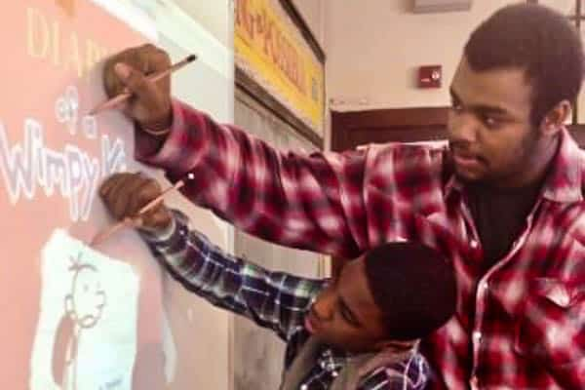
Welcome!
We will get started at 4:00 EST
You can find all the resources needed for today in our tool kit at: http://equityliteracy.org/toolbox2
Introductions: In the chat…
Name, location, and:
At what grade level did you have your first Black male teacher?

Slide 2
Racial Equity Facilitator Training, Day 3
Host: Tess Ormseth
Facilitators: Marceline DuBose & Paul Gorski
http://EquityLiteracy.org

Slide 3
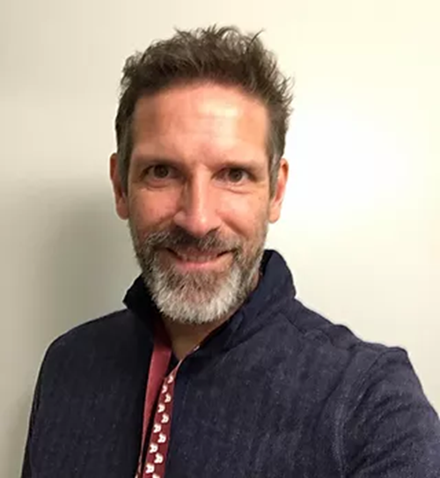
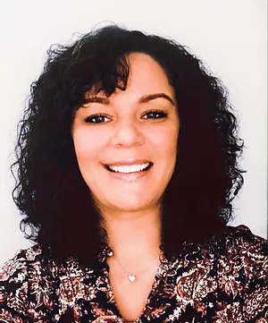
Welcome
Quick (re)intros
Grounding Thought: In the chat…
Where do you want to grow or improve as a racial equity facilitator?

Slide 4
A Few Notes
4-6:30 ET, with 15-minute break
Yes, we are recording
Take notes on what is said, all slides are provided to you. (you may want to timestamp your notes)
Please share your thoughts and questions in the chat! we will be gathering questions for an open Q & A during the final 20 minutes.

Slide 5
Equity Ideologies: Challenging Deficit and Grit Views

Slide 6
What is ideology?
A belief system or set of mental models
Drives our advocacy and actions, or lack thereof

Slide 7
The Practical Importance of Ideology
This is a fact: Studies show Black students are more likely than white students to be suspended or expelled from school.
How do I interpret this fact?
Backstage: You can start with an actual question like this, have people discuss in small groups, then map their responses onto the three ideologies

Slide 8
(Other Possible Facts)
Black people are incarcerated in state prisons at a rate 5.1 times that of White people. Why?
Incarcerated for drug offenses
In poverty…

Slide 9
Interpretation to Action
Common and Wrong Interpretation:
Black students misbehave more than white students.
So, what are my solutions given this interpretation?

Slide 10
Interpretation to Action
Less Common and Research-Based Interpretation:
Racial bias. Teachers interpret behaviors differently among Black students and among white students.
So, what are my solutions given this interpretation?

Slide 11
Because Some of You Are Doubting
References
Girvan, E.J., Gion, C., McIntosh, J., & Smolkowski, K. (2017). The relative contribution of subjective office referrals to racial disproportionality in school discipline. School Psychology Quarterly, 32, 392-404.
Huang, F. L. (2016). Do Black students misbehave more? Investigating the differential involvement hypothesis and out-of-school suspensions. The Journal of Educational Research, 111, 284-294.
Kunesh, C. E., & Noltemeyer, ?A. (2019). Understanding disciplinary disproportionality: Stereotypes shape pre-service teachers’ beliefs about Black boys’ behavior. Urban Education, 54, 471-498.

Slide 12
Because Some of You Are Doubting
Girvan et al. (2017): Based on office discipline referral (ODR) records of 1,154,686 students in 1,824 US schools:
“Results showed that disproportionality in subjective ODRs explained the vast majority of variance in total disproportionality.”

Slide 13
However…
When we map out what schools are doing in response to this disparity, are they:
Eliminating the racism?
Attempting to adjust the behaviors, mindsets, and emotions of Black students?
Not about the right practice, but about the right ideology

Slide 14
What is deficit ideology?

Slide 15
Deficit Perspective
Tendency to focus on people’s weaknesses—what they lack—rather than their strengths

Slide 16
Deficit Ideology
Belief system that locates the primary cause of disparities—test score gaps, incarceration rates, poverty rates, etc.—within rather than pressing upon the communities of color

Slide 17
Hearing Deficit Ideology
“Those parents don’t care about their children’s education.”

Slide 18
Hearing Deficit Ideology
“Those XYZ Neighborhood kids don’t have any role models at home.”

Slide 19
Hearing Deficit Ideology
“Some people simply refuse to take advantage of the opportunity presented to them.”

Slide 20
Hearing Deficit Ideology
Quick Reflection:
What are examples of comments you’ve heard or thoughts you’ve had that reflect this sort of racism-infused deficit ideology?

Slide 21
If Not Deficit Ideology, Then What?

Slide 22
The Attribution Ideologies
Deficit ideology
Grit ideology
Structural ideology

Slide 23
The Attribution Ideologies
Deficit ideology
Grit ideology
Structural ideology
Like deficit ideology, grit and structural ideologies refer to what we identify as the cause of disparities.

Slide 24
Deficit Ideology
Belief system that locates the primary cause of disparities—test score gaps, behavior disproportionalities in schools, incarceration rates, poverty rates, etc.—within rather than pressing upon communities of color
So solutions focus on “fixing” those communities

Slide 25
Deficit Ideology
What we try to ”fix”
mindsets
cultures
attitudes
behaviors
What we ignore
Racial bias, institutional and structural racism

Slide 26
Grit Ideology
Belief system that attributes disparities to shortages of resilience and grit within communities of color
So solutions focus on strengthening those communities’ “grit”

Slide 27
Grit Ideology
What we try to ”fix”
grit
resilience
What we still ignore
Racial bias, institutional and structural racism

Slide 28
Structural Ideology
Belief system that attributes disparities to unjust distributions of access and opportunity—to institutional, cultural, and structural racism
So solutions focus on eliminating racism

Slide 29
A Summary in Questions
Deficit ideology impulse: What do we need to help adjust about those families so they can perform/behave/think differently (while we ignore racism)?
Grit ideology impulse: How can we help those families be grittier so they can overcome challenges and barriers related to racism?
Structural ideology impulse: What are the barriers and challenges? How is racism operating How do I contribute to it? How can we eliminate it?

Slide 30
Deficit Ideology in Your Organization
What is an example of a policy, practice, or program touted as equity-based in your organization that reflects a deficit ideology? Or a grit ideology?
What is a different action or approach that would reflect a structural ideology?

Slide 31
Cultivating Structural Ideology

Slide 32
Structural Impulse
What are the challenges, barriers, inequities, and biases? How is racism operating? What are the challenges, barriers, inequities, and biases? How is racism operating? What are the challenges, barriers, inequities, and biases? How is racism operating?

Slide 33
Opening a New Window
“I wonder” statements
What are the challenges and barriers—the biases and inequities? How is racism operating?
Refocus on what we can do, on our spheres of influence

Slide 34
Example
“XYZ families never show up for family engagement. Doesn’t that prove they’re not invested in their children’s education?”
I wonder
Biases, inequities racism
What can we do?

Slide 35
15-minute Screen Break! Some ideas…
Water the plants
Throw in a load of laundry
Dance to a song or two
Step out and take a deep breath of fresh air
Hug someone in your house
Stretch or yoga

Slide 36
Racial Equity
Group Development
Session Design

Slide 37
Design Considerations
Sequencing
Use of ice-breakers, warm-up and community building activities
Concept-development and paradigm-shifting
Types and use of “activities”
Pacing
Facilitator posture
Considering group size and positionality
Considering previous organizational work
Co-facilitation
Virtual or in-person considerations

Slide 38
General Sequencing/Design
Introduction & discussion of goals
Ice-breaker or safe lead-in
Concept-development and paradigm-shifting
Acknowledgement of the problem
Information-sharing
Higher-risk exercise and discussion
Practical application
Final reflections

Slide 39
Sequencing: Quick Reflection
Why we don’t do ground rules or group norms or community agreements.

Slide 40
Sequencing 2: Narrative Icebreaker
Inclusion/Exclusion
Free write, then in small groups:
Share a time when you felt alienated, disengaged, invalidated, excluded in a classroom [or work or…] environment.
Share a time when you felt especially engaged, validated, empowered.

Slide 41
Sequencing 2a: Benefits of the Narrative Icebreaker/warm up
Invites all voices into the conversation
Humanizes participants and the facilitator
Provides opportunity for people to connect with the feeling of alienation (which we then can connect with bigger inequities)
Balances head work and heart work
Must give people the option of sharing or not sharing
Must avoid using a specific enough activity that it requires participants of color (participants of the global majority) to be “props” in the equity learning of white people

Slide 42
Reflection
What is the kind of warm-up activity you find especially useful and engaging?
What is the kind of warm-up activity that makes you anxious or uncomfortable?

Slide 43
Bad Group Activities Reflection
What is an activity you have participated in or used that can be interpreted as using People of Color / BIPOCs / People of the Global Majority as “props” or “learning resources” for white participants?
What is a different learning activity that can get to the same learning objectives without doing so?

Slide 44
Sequencing 3: Concept-Development & Paradigm-Shifting
Example: The Layers of Racism
Another example: interest convergence (see next several slides)

Slide 45
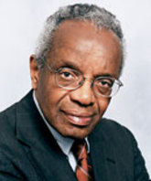

Slide 46
Interest Convergence
White people and white-dominated institutions will invest in racial justice efforts as long as their interests align (or “converge”) with the interests of racial justice.
As soon as the interests diverge, they will disinvest.

Slide 47
So…
Racial justice gains are made when they benefit white people.

Slide 48
Interest Convergence and Racial “Diversity and Inclusion” Efforts
School and organizational leaders know that, at the very least, the optics of concern about equity is important, so most racial equity efforts are high on optics: cultural programs, “diverse” curricula, and so on
However, must schools and organizations fall considerably short of addressing racial equity in more serious, redistributive ways (because this is where interests diverge)

Slide 49
Sequencing 4: The Interest Convergence Measuring Stick (Applying the Concept)
In your school or organization, what is the point of divergence—the point at which more serious racial justice efforts are met with criticism and backlash?
This is where the interests of racial advantage come into conflict with the interests of racial justice.

Slide 50
Sequencing 4: Analysis and Application
See linked handouts in our toolbox for more exercises

Slide 51
Design Issue 3: Types and Use of Activities
Types:
Simulations
Institutional analysis
Self-reflection
Small group conversations
Case studies
Watch (video) and respond
Idea/solution generation
Others?
Considerations for Use of Activities:
Purpose
Time required
Ability to apply and reflect (which is where the learning actually happens)
Emotional impact

Slide 52
Pacing 1: Pacing for Privilege Detour & Prioritization Principle
Racial equity detour “Pacing for Privilege”:
Pacing change efforts to prioritize the interests of people least interested in those efforts rather than the interests of the people most desperate for those efforts
Prioritization Principle: By definition, antiracist work actively prioritizes the interests of BIPOCs

Slide 53
Pacing 2: Org Change Theory
20 | 60 | 20
The trouble with “baby steps” and “meeting people where they are”
Looking at layers: the institution has to move at the pace of the people desperate for it to move even if some individuals aren’t moving that fast

Slide 54
Additional Design Considerations
What if I don’t get to everything? What if I run out of content?
Visuals and content delivery
Should I use humor? How? or Why not?
Sequencing over multiple sessions
Facilitator posture
Expert? Critical Friend? Coach?
Group size and positionality
Previous organizational equity work/Upcoming planned equity work
Co-facilitation
Virtual vs. in-person

Slide 55
Closing: In the chat…
What is your primary take-away today?
See you next week!

Slide 56
http://EquityLiteracy.org
gorski@EquityLiteracy.org
@pgorski / @EquityLiteracy

