Slide 1
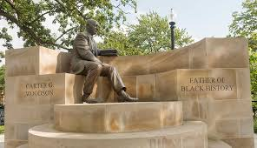
Welcome!
We will get started at 4:00 EST
You can find all the resources needed for today in our tool kit at: http://equityliteracy.org/toolbox2
Introductions: In the chat…
Name, location, and a person(s) or event from Black History that inspires you

Slide 2
Racial Equity Facilitator Training, Day 2
Host: Seema Pothini
Facilitators: Marceline DuBose & Paul Gorski
http://EquityLiteracy.org

Slide 3
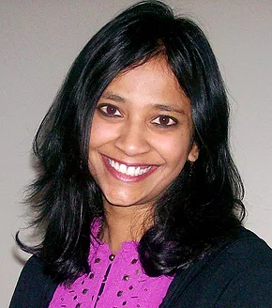
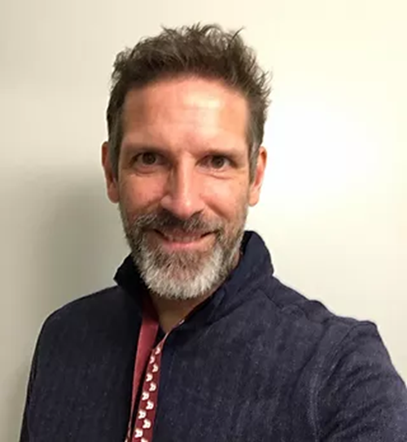
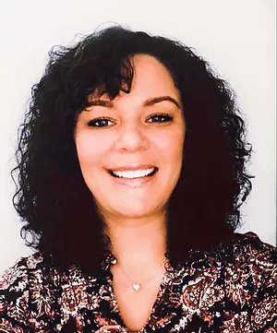
Welcome
Quick re-intros
Grounding Thought: In the chat…
What have you been noticing or thinking about since last week?

Slide 4
A Few Notes
4-6:30 ET, with 15-minute break
Yes, we are recording
Our work is mostly with schools, universities, and non-profits; we’ll provide examples from different contexts
We will be using our reflection log (3-minute reflection time between ideas)
Take notes on what is said, all slides are provided to you. (you may want to timestamp your notes)
Please share your thoughts and questions in the chat! Seema will be gathering questions for an open Q & A during the final 20 minutes.

Slide 5
Revisiting the Layers of Racism

Slide 6
The Layers
Ideological Racism
Individual Racism
Institutional Racism
Cultural Racism
Structural Racism
Sociohistorical Racism

Slide 7
Ideology to Action
My ideology
How I interpret a disparity
Solutions I can imagine for the disparity
Actions I choose to address the disparity
Extent to which I’m a threat to inequity or to the possibility of equity

Slide 8
Socio-historical Racism
The way we’re socialized to make meaning of race—ascription of inferiority, for example—is so deeply embedded in people’s psyches and normalized that it’s implicitly considered by many people to be the truth

Slide 9
Socio-historical Racism
Example: I have been socialized implicitly to be fearful of Black, Latinx, and Indigenous people-–socialized to interpret their behaviors as particularly threatening or hostile in ways I wouldn’t interpret the same behaviors in white students.

Slide 10
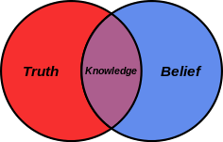
Ideological Racism
The result of socio-historical racism is ideological racism, informing worldviews and belief systems
Note: ideological racism also can be a choice—people can (and often do) adopt a white supremacist ideology even if they don’t necessarily believe in inherent white superiority

Slide 11
Ideological Racism
Example: I embrace and defend racist belief systems with which I was socialized, such as the belief that Black, Latinx, and Indigenous students misbehave more because their families don’t discipline them, even when presented with evidence that this is untrue (which it is). I can choose to have a different belief system, but I am comfortable with a belief system that assumes inferiority in “those people.”

Slide 12
Individual Racism
The result of ideological racism informing interpersonal interactions. One person takes a “racist” action against another person.
Not a question of intention, but a question of impact

Slide 13
Individual Racism
Example: I take specific acts based on my ideological racism, such as by referring a Black, Latinx, or Indigenous student for discipline in a situation in which I would not do the same for a white student. I might not realize I’m perpetuating racism, because I’m behaving based on my unchecked ideological racism. It’s not about intent, but about impact.

Slide 14
Institutional Racism
The implications of ideological racism operating in an institution (like a school, district, board, or university). Can be enacted through policies, practices, unspoken aspects of institutional culture that target or harm People of Color while advantaging white people.

Slide 15
Institutional Racism
Example: Racial bias in policies, practices, and ideologies at my school, district, or board result in a pattern of Black, Latinx, and Indigenous students being suspended or expelled at higher rates than white students.

Slide 16
Cultural Racism
Messaging about white superiority through sources that control the means of perception: the media, textbooks, social mores, and so on. Cultural racism feeds a sense of white superiority by suggesting white or European exceptionality.

Slide 17
Cultural Racism
Example: School literature courses foreground and normalize works by white authors while exoticizing or separating out works by author of color.

Slide 18
Structural Racism
The network of unjust distributions of access and opportunity built into all systems and structures in society that accumulatively advantage white people and their interests and disadvantage People of the Global Majority (People of Color) and their interests.

Slide 19
Structural Racism
Example: Due to the accumulative impact of racism in and out of schools, students of color are at a disadvantage in school and pushed into the school-to-prison pipeline

Slide 20
Shift One
Racism as solely individual, interpersonal actions
Racism as structures of advantage and disadvantage

Slide 21
Shift Two
Racism as an occasional incident that needs to be addressed when witnessed or reported
Racism as ordinary and impacting everything, so we need to proactively be address it all the time

Slide 22
Shift Three
Racism as solely a prejudiced belief system that can be adjusted with anti-bias training
Racism as the accumulative impact of institutional, cultural, and structural racial injustice that must be addressed at their ideological, institutional, cultural, and structural core

Slide 23
Racial Equity Facilitation: Considerations and Reflections (a backstage discussion)
Which of the layers of racism are most difficult to facilitate with a group? Why?
How do you enlist people who benefit from institutional and structural racism in the efforts to dismantle it?

Slide 24
Dr. Derrick Gay
How do you go about designing and sequencing racial equity workshops?
What considerations are included in your planning?
How do you decide how hard to push or at whose pace you move the conversation forward?

Slide 25
Screen Break!
See you in 15 minutes!!

Slide 26
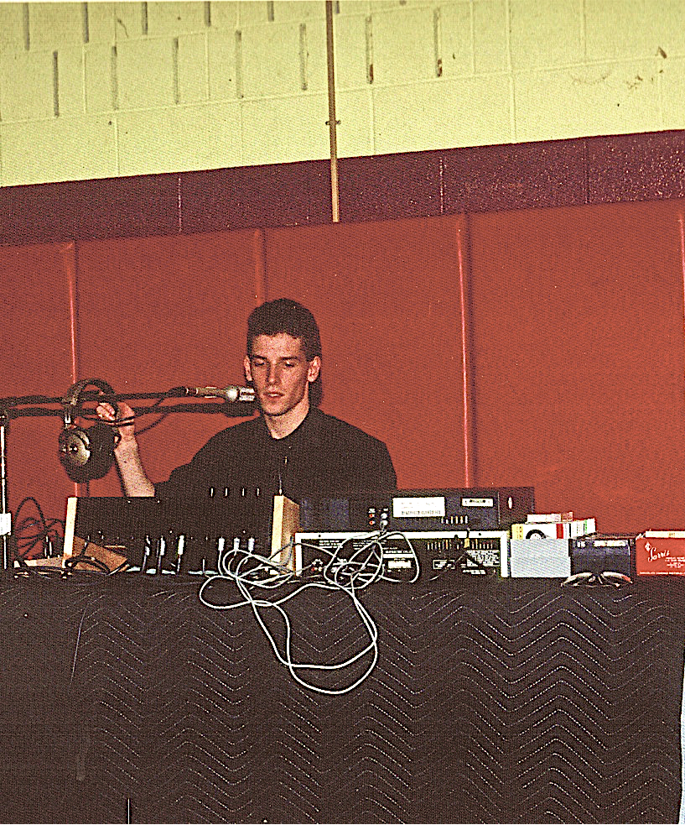
Welcome Back!
Younger Paul as a DJ!

Slide 27
Distinguishing Mitigative and Transformative Equity

Slide 28
Illustration: Addressing “Homelessness”
Mitigative . . . . . . . . . . . . . Transformative
What are the most common things people and organizations do in response to homelessness—to support people experiencing homelessness?

Slide 29
Parable 1: The Starfish
The “respond” ability of equity literacy—short term reaction
The trouble with the Starfish approach to equity
“Starfish” initiatives?

Slide 30
Parable 2: The Babies in the River
The “redress” ability—transformative change at the roots
The difficulty of transformative approaches
Transformative initiatives?

Slide 31
Illustration: Addressing “Homelessness”
Mitigative . . . . . . . . . . . . . Transformative
Are we addressing the causes of homelessness or helping people who are homeless survive as people who are homeless?
(We need to do both, of course. But we actually need to do both.)

Slide 32
Reflections (reflection log)
What are examples of things your organization does in the name of racial equity that might nibble around the edges of inequity but don’t actually create more equity?
What would a transformative equity approach look like?

Slide 33
Five Abilities of Equity Literacy

Slide 34
Purpose of the Five Abilities
They allow us to apply a strong equity lens to everything we do
They provide an outline for what the thrust of equity professional learning ought to focus on

Slide 35
Equity Literacy Abilities
Recognize inequity
Respond to inequity
Redress inequity
Actively cultivate equity
Sustain equity

Slide 36
1. Recognize Racism
Do I recognize even the subtlest bias and inequity in my sphere of influence?
I can’t respond to or redress an inequity I don’t recognize

Slide 37
2. Respond to Racism
When a bias or inequity becomes apparent in a particular instance, do I have the skills and the will to respond?
Reactive, in the immediate term

Slide 38
3. Redress Racism
Do I have the knowledge and skills to understand how individual instances of racial inequity are usually related to bigger sets of conditions related to individual ideology and institutional culture? Am I able to redress those instances by proactively addressing their root causes?

Slide 39
4. Actively Cultivate Antiracism
Do I have the knowledge, skills, and will to apply an antiracist lens to every discussion, every decision? Is racial equity an add-on or afterthought or do I actively cultivate it through every policy and practice and throughout institutional culture?

Slide 40
5. Sustain Antiracism
As we progress toward a full antiracist commitment, people who are used to the advantage of extra access and opportunity are going to complain and attempt to slow or reverse that progress. Do I know how to sustain equity efforts in the face of this push-back? Do I have the will to do so?

Slide 41
Using Case Studies

Slide 42
Case Study Analysis Framework
You can find many case studies in our tool kit at: http://equityliteracy.org/toolbox2
Ours are mostly about education or working with youth, but feel free to modify in ways that serve your work.
Let’s walk through an example. We’ll look at the one linked on the resources page, Black Lives Matter!

Slide 43
Let’s Practice! Case Study…
Black Lives Matter!

Slide 44
Case Study Group Analysis
Recognize inequity
Respond to inequity
Redress inequity
Actively cultivate equity
Sustain equity
What are some reasons educators might be fearful about introducing conversations about racism in their classes? What can school leaders do to alleviate that fear? What can we do as individual educators to alleviate that fear in ourselves?
If you were a teacher at East City, how would you respond to students wearing “All Lives Matter” shirts to help them distinguish that point from the importance of a movement insisting “Black Lives Matter”?

Slide 45
Racial Equity Facilitation: Considerations and Reflections (a backstage discussion)
Why did you write the case studies? What purpose do they serve?
What has been your experience using case studies with groups?
What are the limitations of case studies in group facilitation?
How do you bridge your groups from the hypothetical to reality and action?

Slide 46
Important Announcements

Slide 47
Part 2! March Advanced Facilitator Training
Two-day training, March 11 & 18, 4-6:30 EST
Only open to people who participated in our October 2020 10-hour training or our February 2021 10-hour training
More info:
https://facilitators2.eventbrite.com

Slide 48
Let’s do this again! October 2021 Facilitator Training
Tuesdays, 4-6:30 PM EST
More info:
https://facilitators3.eventbrite.com

Slide 50
http://EquityLiteracy.org
gorski@EquityLiteracy.org
@pgorski / @EquityLiteracy

